Slide 1
Harnessing the Power of Big Data: A Big Data Analysis of Digital Music Reviews using PySpark
CS 532 Project
Team members:
Charchit Saraswat,Debanjan Mondal, Niyati Sharma, Siddharth Jain

Slide 2
Objective
We aim to build a scalable end-to-end pipeline for a review sentiment classification system using PySpark
We retrieve the customer reviews from Amazon Review Data and train multiple ML models to classify customer sentiments
Data Source : https://cseweb.ucsd.edu/~jmcauley/datasets/amazon_v2/
Category : Digital Music(1,584,082 reviews)
We seek to compare the performance of various ML models
We intend to gauge critical system metrics such as latency, CPU utilization, and memory usage across various system configurations

Slide 3
Motivation
Platforms like Amazon, Yelp accumulate a substantial volume of customer reviews
Manual review analysis is time-consuming, requires extensive labor, and susceptible to human biases
Implementing automation is crucial for the effective handling and analysis of the extensive online feedback
PySpark facilitates distributed computing, enabling the efficient processing of extensive datasets, fostering scalability in data operations

Slide 4
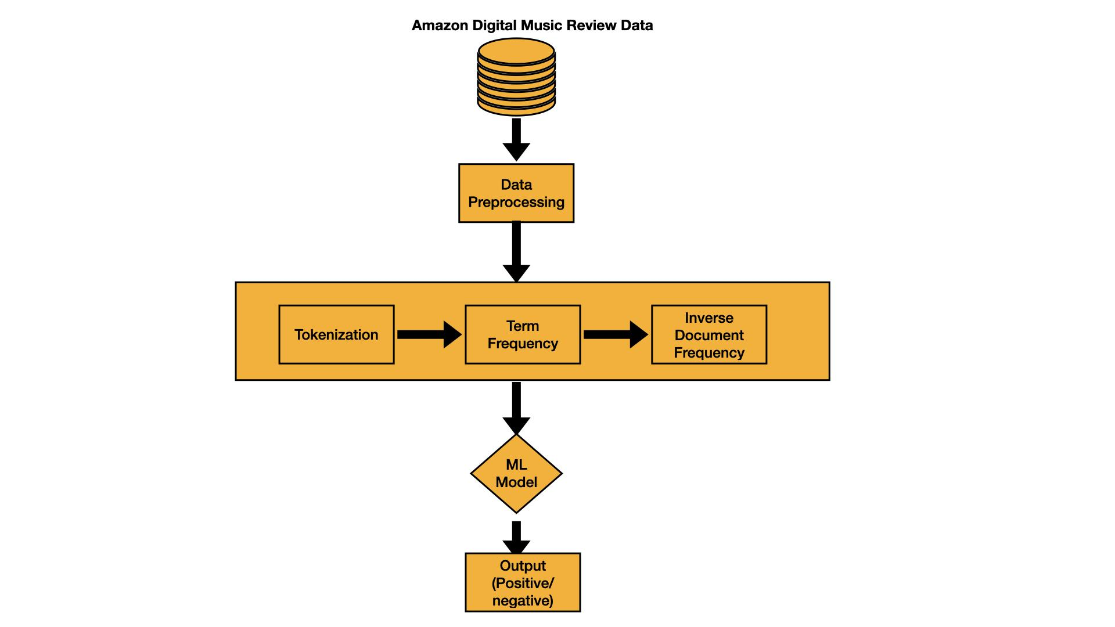
Pipeline

Slide 5
Methodology - Data preprocessing
Create a dataframe from the reviews dataset
Filter out the null values for reviewText, replace null values in summary column with empty string for the summary field
Create a primary key
Finally, the dataframe is split into training, validation, and test
To measure performance, we ran PySpark on the main thread and spawned a parallel thread to run the monitoring code.
To extract system data we used psutil and measured it at an interval of 1 sec

Slide 6
Methodology - Algorithms
Naive Bayes
A probabilistic classification algorithm based on Bayes’ theorem
Assumes strong independence between the features
Support Vector Machine (SVMs)
An algorithm for classification tasks that finds an optimal hyperplane to maximize the margin between classes.
Logistic Regression
A classification algorithm that predicts the probability of categorical outcomes using a logistic function.

Slide 7
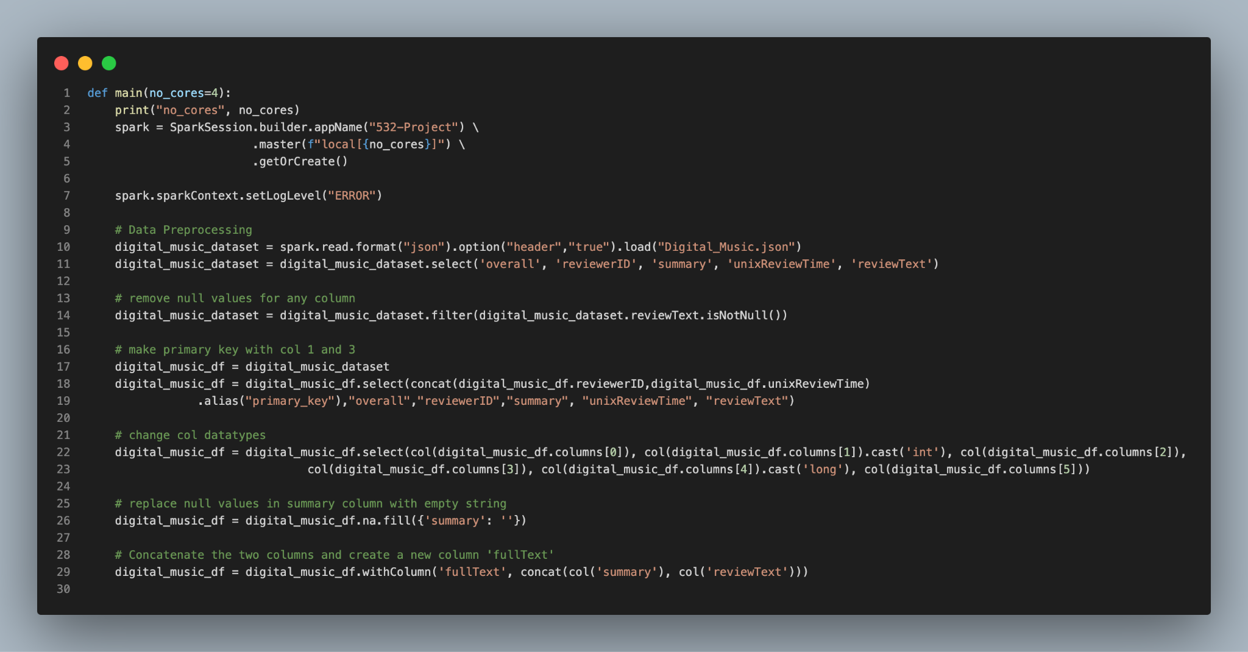
Code Snippets - Data Processing

Slide 8
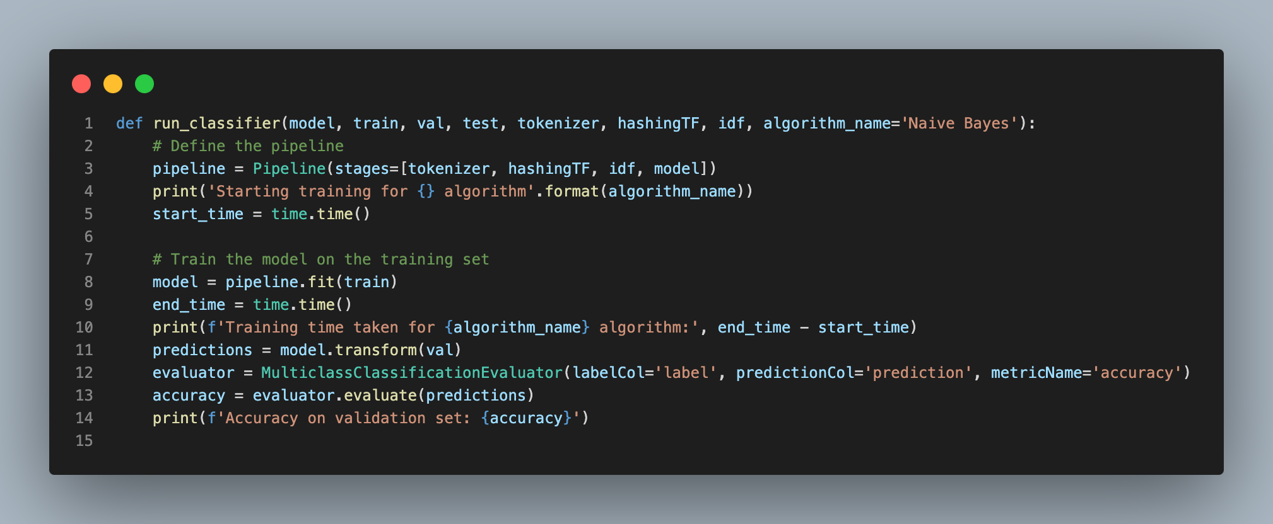
Code Snippets - Training and Evauation

Slide 9
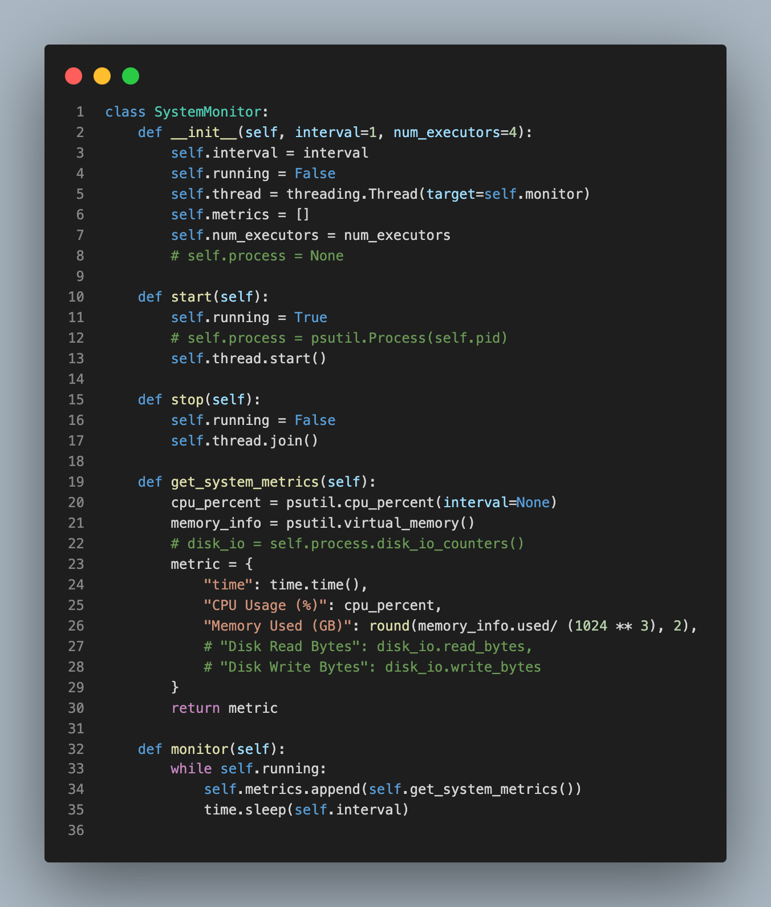
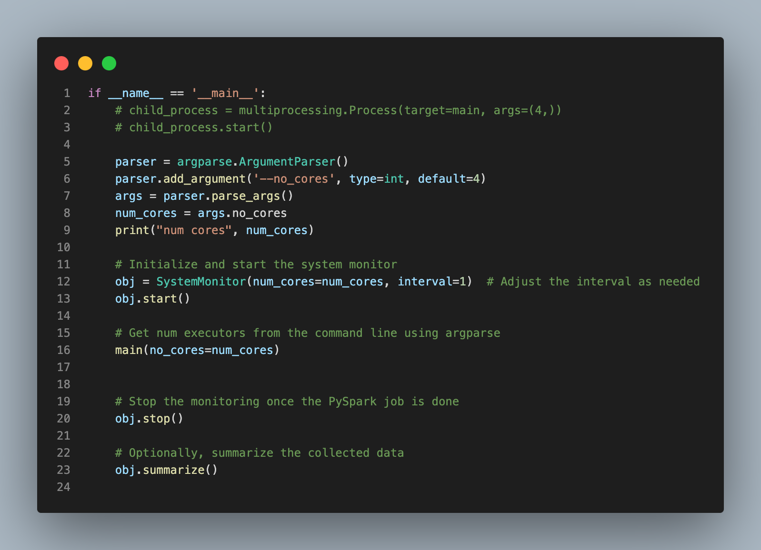
Code Snippets - Monitoring

Slide 10
Contributions
Charchit Saraswat:
Write code for monitoring the performance of pyspark using psutil and multi-threading.
Created plots from the collected monitoring data.
Debanjan Mondal:
Worked on data fetching and pre-processing.
Focused on implementation of Naive Bayes, SVM and Logistic Regression in PySparkML
Niyati Sharma:
Installing dependencies and setup environment for Windows OS.
Run scripts and analyze the performance metrics on Windows OS.
Siddharth Jain:
Installing dependencies and setup environment for Mac OS.
Run scripts and analyze the performance metrics on Mac OS.

Slide 11
Possible Improvements
Handling class imbalance
As the dataset is highly imbalanced, we can use techniques such as oversampling or undersampling to improve performance.
Distributed training
We only explored training in one machine. DIstributed training across multiple GPU clusters can speed up the training process significantly
Real Time Monitoring
We can use real-time monitoring tools like Grafana and Prometheus. Alerts can be setup for CPU and memory utilization on these tools to inform about possible failures and crashes. We can add retries in case of failures.

Slide 12
Tests - Monitoring
To test the sanity of our monitoring system, we shut down all the applications on our systems.
We created a simple counting while loop on the main thread while our monitoring thread read the resource utilization data with psutil.
We ensured that reading from our monitoring system made sense with what we were seeing on Top in MacOS and Task Manager on Windows OS.

Slide 13
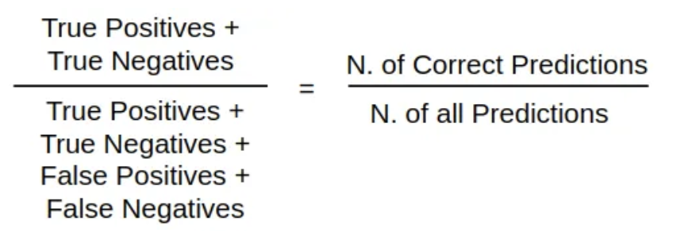
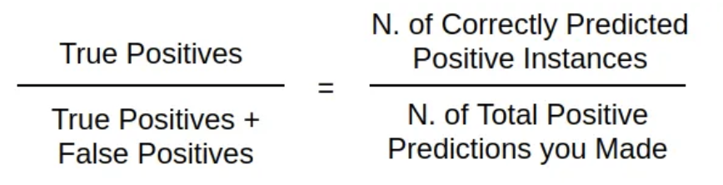
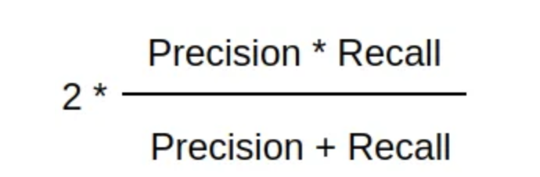
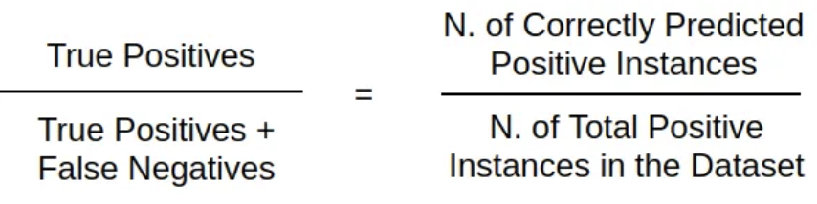
Tests - Evaluation Metrics
For the classification tasks, we evaluate the models on the following metrics
Accuracy
Precision
Recall
F1 score

Slide 14
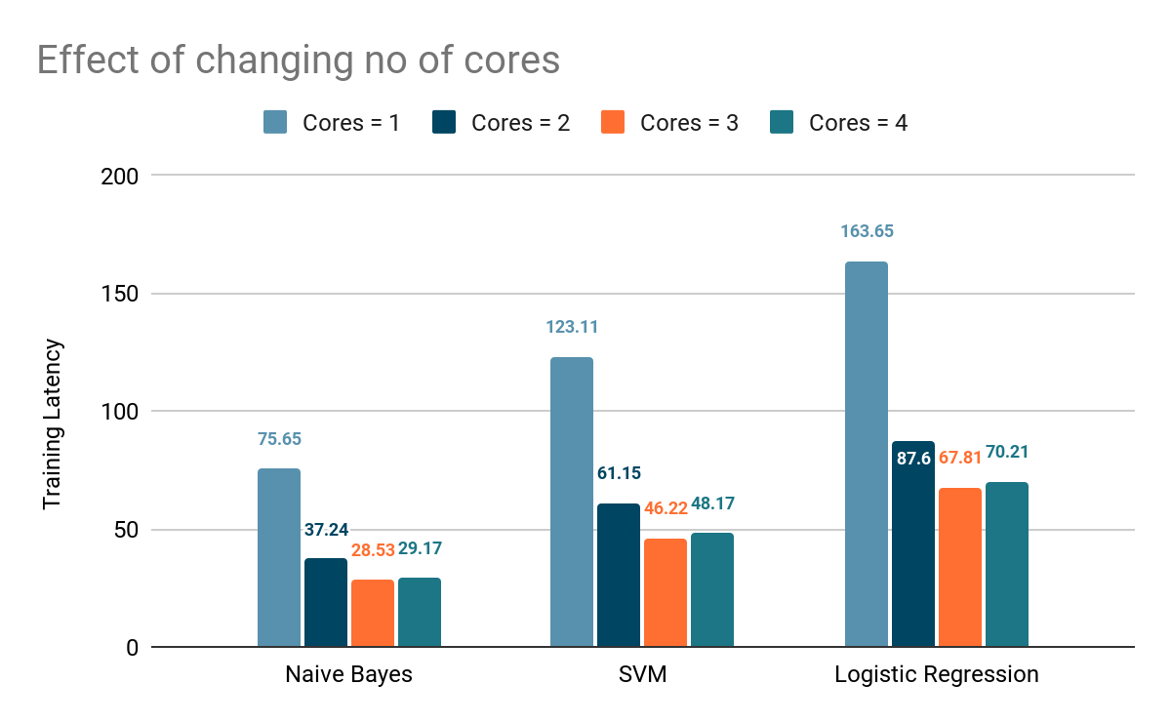
Training Latency - Local Mode
We run PySpark in local mode and vary the no of cores that will be utilized.
We observe that latency steadily decreases as no of cores is increased to 3, then it slightly increases
We hypothesize that when we use 4 cores the jobs compete for resources causing more context switches, thus increasing the latency slightly
Using 3 cores produces optimal performance
CPU: MAC M1 Apple Silicon
Notes:
We execute PySpark in a local mode, adjusting the number of cores utilized. We notice a consistent decline in latency as the no of cores increase until reaching 3. This illustrates the impact of distributing data processing across multiple CPU cores. However, with 4 cores, a slight latency increase is noticed. We hypothesize that employing many cores prompts resource competition among jobs, leading to additional context switches and a subsequent marginal rise in latency.

Slide 15
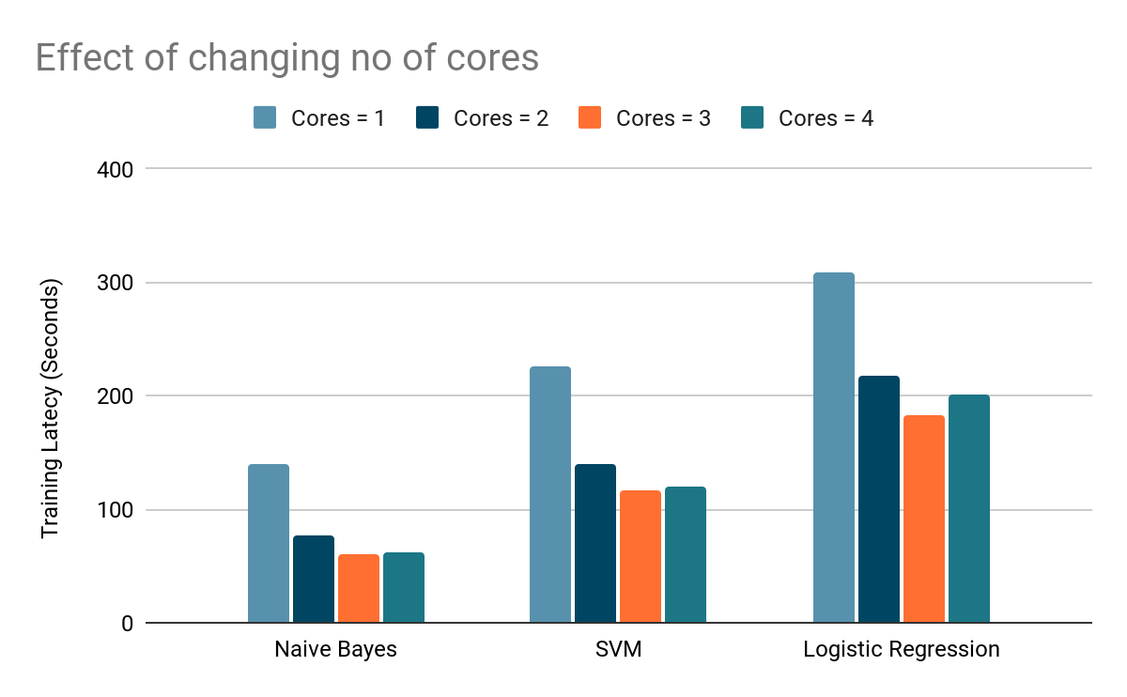
Training Latency - Local Mode Continued
CPU: Intel(R) Core(TM) i5-8265U
Notes:
Similar observation holds for both Apple M1 and Intel i5 CPUs.

Slide 16
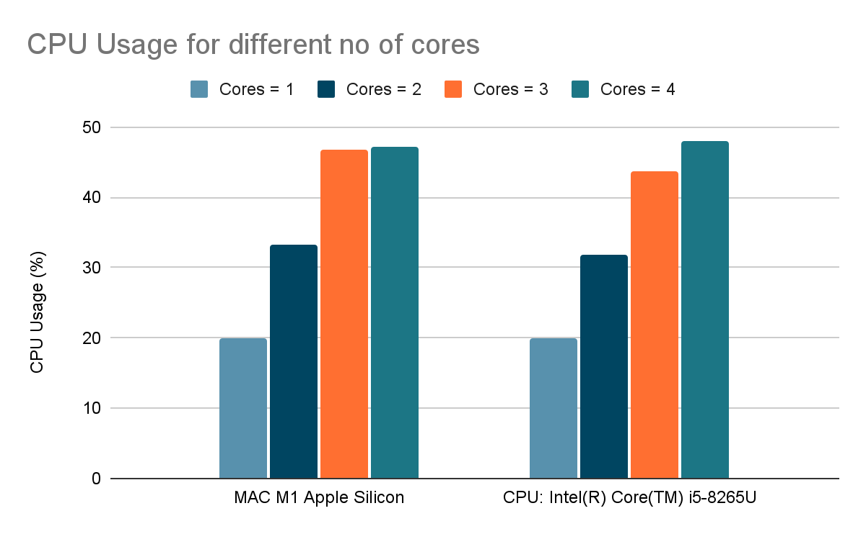
CPU Usage
CPU Usage(%) strictly increases with no of cores used
Notes:
As for CPU usage, we observe a steady increase with no of cores utilized. Increasing no of cores allows more tasks to be processed simultaneously which leads to higher CPU utilization as more cores are active at the same time.

Slide 17
Experimental Results - Latency and Resource Utilization
OS(CPU architecture) | No. of Cores | Naive Bayes Latency (secs) | SVM Latency (secs) | Logistic Regression Latency(secs) | Avg. CPU Usage (%) | Max CPU Usage (%) | Avg. Memory Usage (GB) | Max. Memory Usage (GB)
MacOS-X (Apple M1 Silicon) - 8 cores and 8GB RAM | 1 | 75.65 | 123.11 | 163.65 | 19.99 | 64.9 | 3.47 | 4.2
 | 2 | 37.24 | 61.15 | 87.60 | 33.23 | 65.10 | 4.14 | 4.33
 | 3 | 28.53 | 46.22 | 67.81 | 46.68 | 78.70 | 4.09 | 4.30
 | 4 | 29.17 | 48.17 | 70.21 | 47.15 | 79.10 | 4.08 | 4.24
Windows (Intel(R) Core(TM) i5-8265U - 8 cores and 8 GB RAM | 1 | 139.13 | 225.82 | 308.10 | 19.97 | 76.10 | 4.54 | 4.94
 | 2 | 76.26 | 138.98 | 217.17 | 31.91 | 61.70 | 4.58 | 4.75
 | 3 | 60.04 | 117.40 | 183.15 | 43.66 | 65.90 | 4.69 | 4.92
 | 4 | 61.60 | 119.58 | 201.31 | 47.99 | 89.10 | 4.80 | 5.16
Notes:
These are all our results compiled into a single table.

Slide 18
Experimental Results - Latency and Resource Utilization
Compare M1 and i5
Latency in Apple M1 were much lower than Intel i5.
CPU Utilization was almost similar across M1 and i5
Memory utilization was higher in Intel i5 across number of cores.
Notes:
Overall, we observe latency in Apple M1 were much lower than Intel i5.
CPU Utilization is almost similar for M1 and i5.
Memory utilization was higher in Intel i5 across number of cores.

Slide 19
Experimental Results - Model Accuracies and Scores
Algorithm | Validation Accuracy | Test Accuracy | Test Precision | Test Recall | Test F1
Naive Bayes | 89.98 | 90.16 | 95.74 | 90.16 | 92.31
SVM | 96.25 | 96.31 | 95.53 | 96.31 | 95.35
Logistic Regression | 96.32 | 96.40 | 96.03 | 96.40 | 96.17
Here we can see that Logistic Regression performed the best on binary sentiment classification.
Notes:
Coming to model performances, we observe that Logistic Regression performs the best on binary sentiment classification on every evaluation metric. All models achieve over 90% accuracy and F1 score.

Slide 20
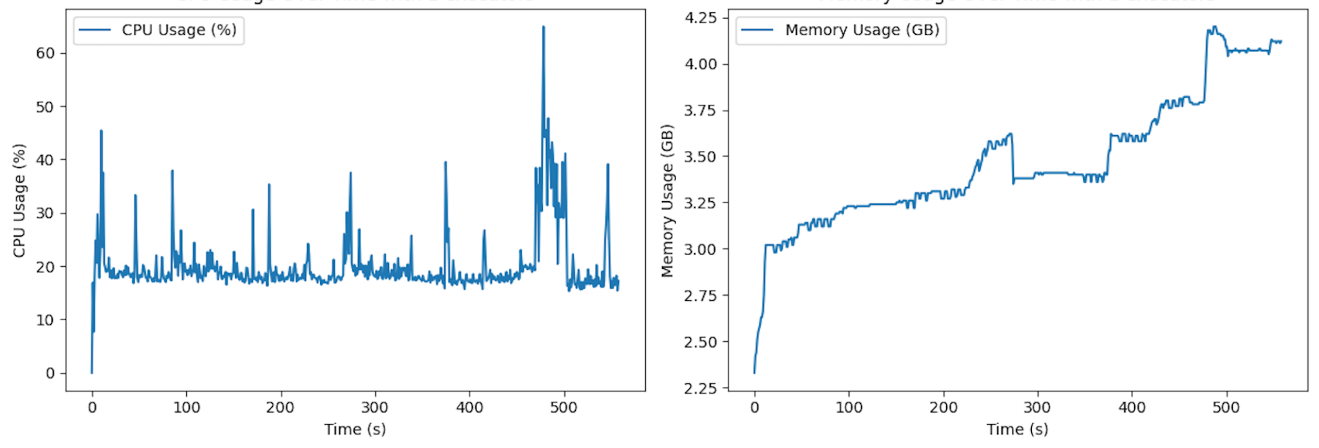
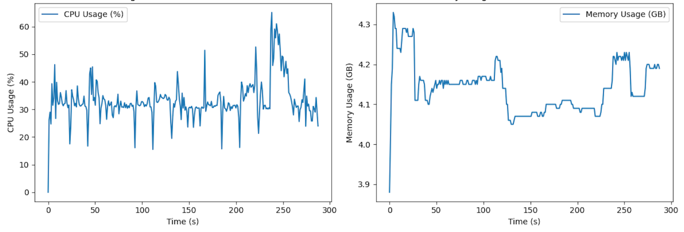
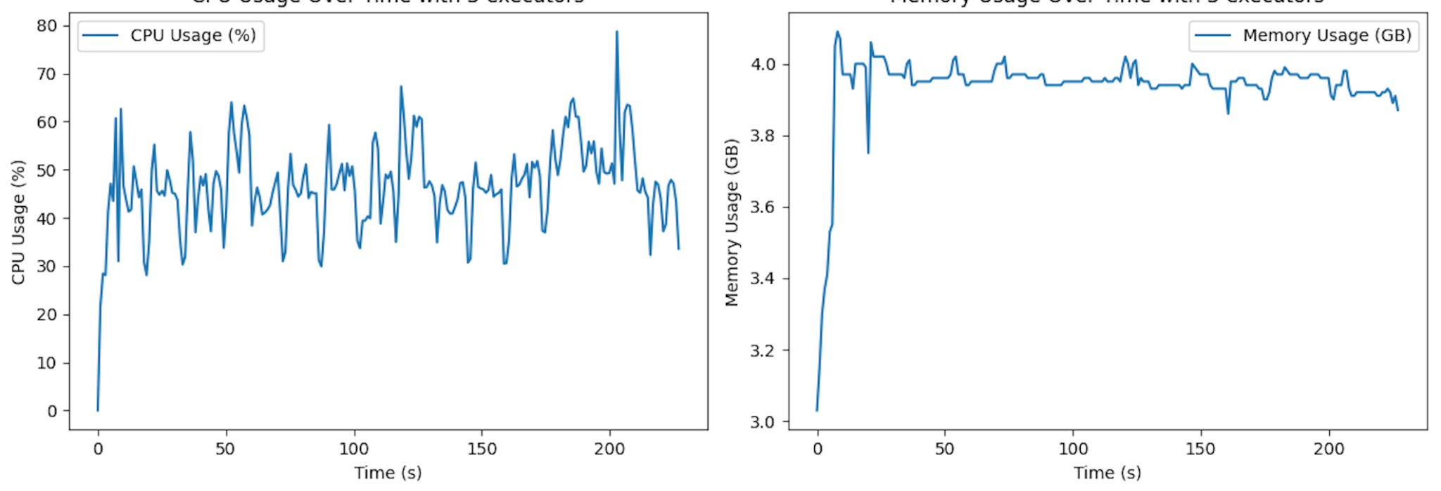
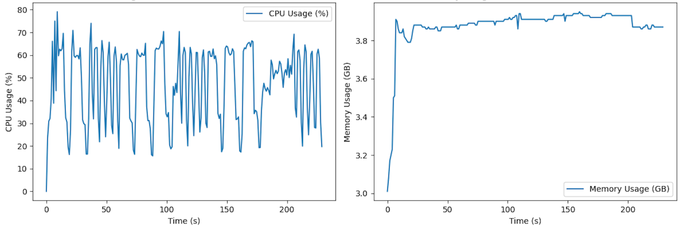
Experimental Results - Resource Plots - Apple M1
Fig1
Fig1 - CPU and RAM utilization with 1 executor and 1 core
Fig2 - CPU and RAM utilization with 1 executor and 2 cores
Fig3 - CPU and RAM utilization with 1 executor and 3 cores
Fig4 - CPU and RAM utilization with 1 executor and 4 cores
Notes:
Here are the CPU and Memory utilization plots for M1 and i5.

Slide 21
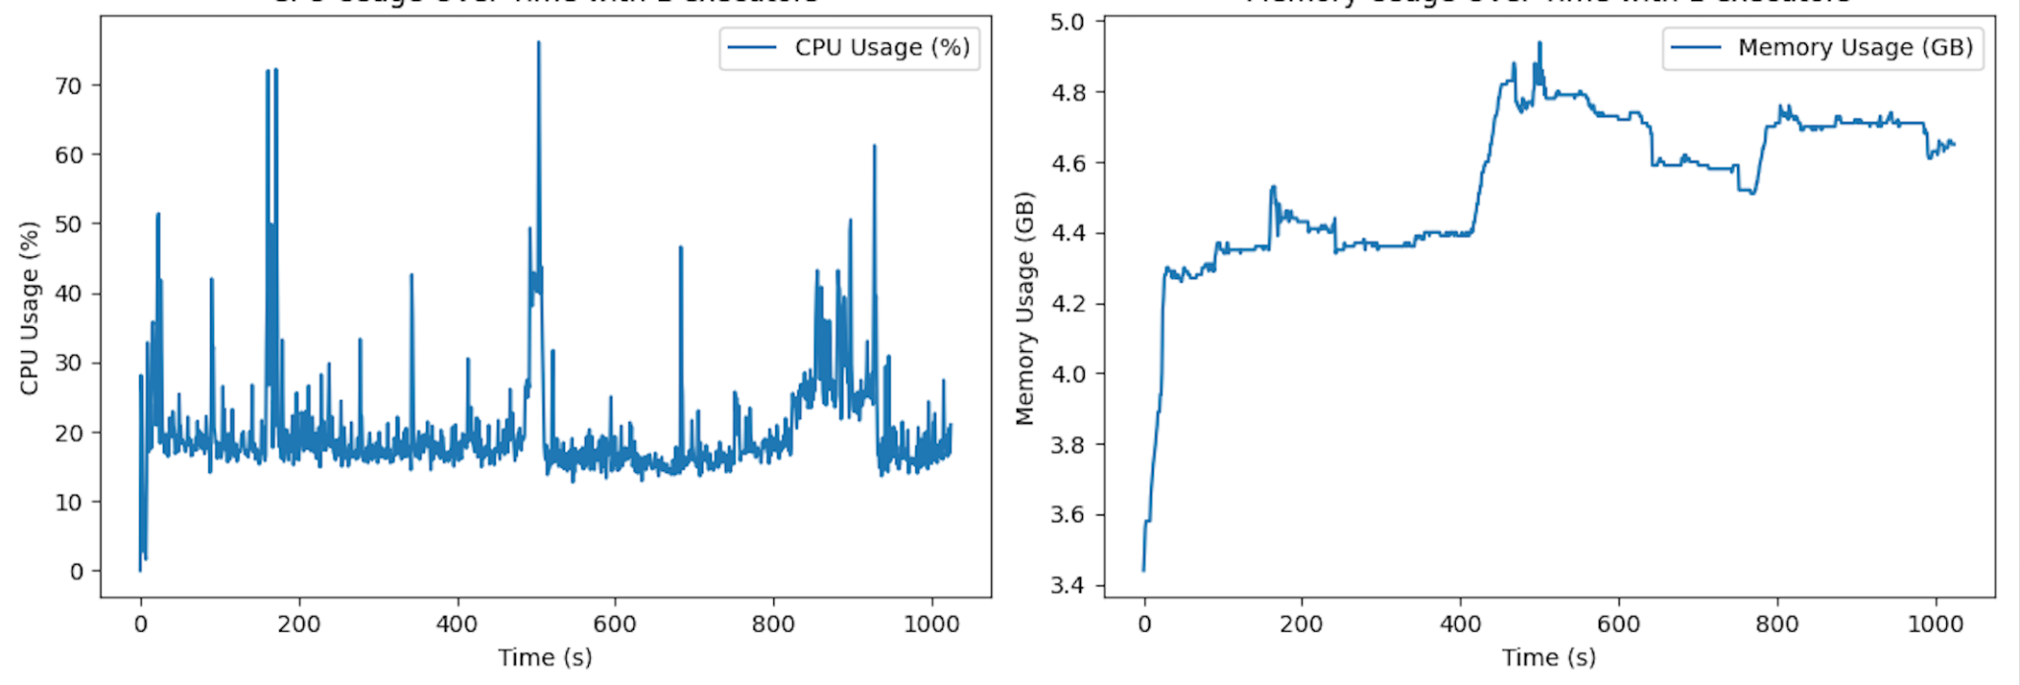
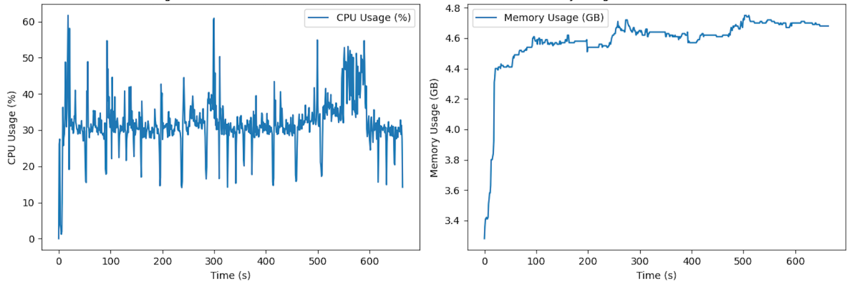
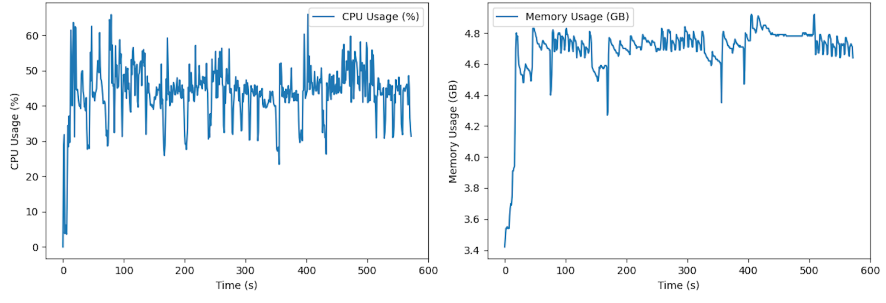
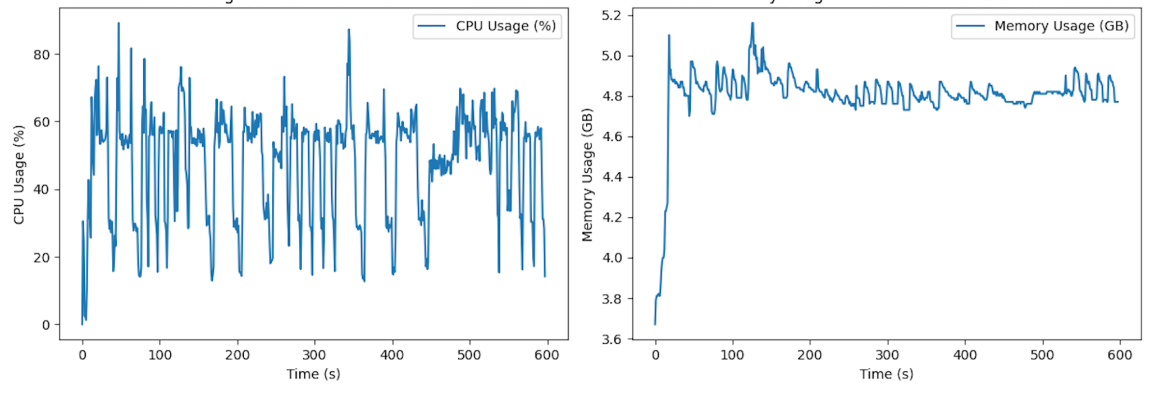
Experimental Results - Resource Plots - Intel i5
Fig1 - CPU and RAM utilization with 1 executor and 1 core
Fig2 - CPU and RAM utilization with 1 executor and 2 cores
Fig3 - CPU and RAM utilization with 1 executor and 3 cores
Fig4 - CPU and RAM utilization with 1 executor and 4 cores

Slide 22
Goals
Explore PySpark ML and machine learning algorithms ✅
We implemented Naive Bayes, SVM and Logistic Regression
Measure key performance metrics ✅
CPU Usage ✅: Plotted usage graph
Latency ✅ : Measured latency for different no of cores and ML algorithms
Memory ✅: Plotted usage graph
Disk I/0 ❌ - psutil measures disk_io_counters using /proc/diskstats file and gives a cumulative io count and includes other processes as well. Hence we could not measure Disk IO instantaneously for only the spark process.
Experiment with different different system configurations ✅
Explored CPU architectures like Mac M1 Apple Silicon and Intel(R) Core(TM) i5-8265U
Varied no of cores to observe the effect of parallelization

Slide 23
Thank you!
Team members: Charchit Saraswat, Debanjan Mondal, Niyati Sharma, Siddharth Jain

